Slide 1

SmartRetail Performance Review: A Data-Driven Analysis
To create an impactful presentation for SmartRetail Company, here is the visual placement guide using your specific data and Power BI retrieval steps.

Slide 2
Business Performance Overview
SmartRetail Strategic Analysis & Growth Roadmap
Total Revenue: SmartRetail is currently a $2.3M revenue business.
Total Profit: The business generated $286k in profit.
Total Quantity: SmartRetail successfully processed and fulfilled a total of 38k in unit per quantity sold.
Growth Trend: Sales have shown consistent year-over-year growth, reaching a peak in 2017.
Core Driver: The Consumer Segment is the primary engine of the business, contributing over 50% of total revenue.

Slide 3
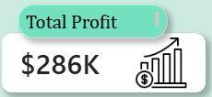
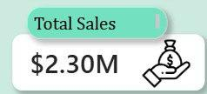
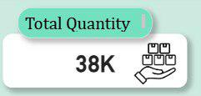
THE BASELINE METRICS
The Headline Figures (Q1):
First, to address Question 1: What is the scale of our operation? We have generated a Total Revenue of 2.3 million dollars (£2.3M). From that revenue, we secured a Total Profit of 286,397 dollars. In terms of volume, we have successfully shipped 37,873 units across all categories. These are healthy headline figures implying a gross margin of roughly 12.5%.

Slide 4
THE BASELINE METRICS
Trends Over Time (Q2):
Moving to Question 2 regarding our trajectory. The trend is undeniably positive. On a yearly basis, both sales and profits have increased consistently every single year from 2014 through to 2017. On a monthly basis, however, we see extreme seasonality. Our business starts slow in January and builds momentum throughout the year, culminating in a massive spike in Q4.

Slide 5
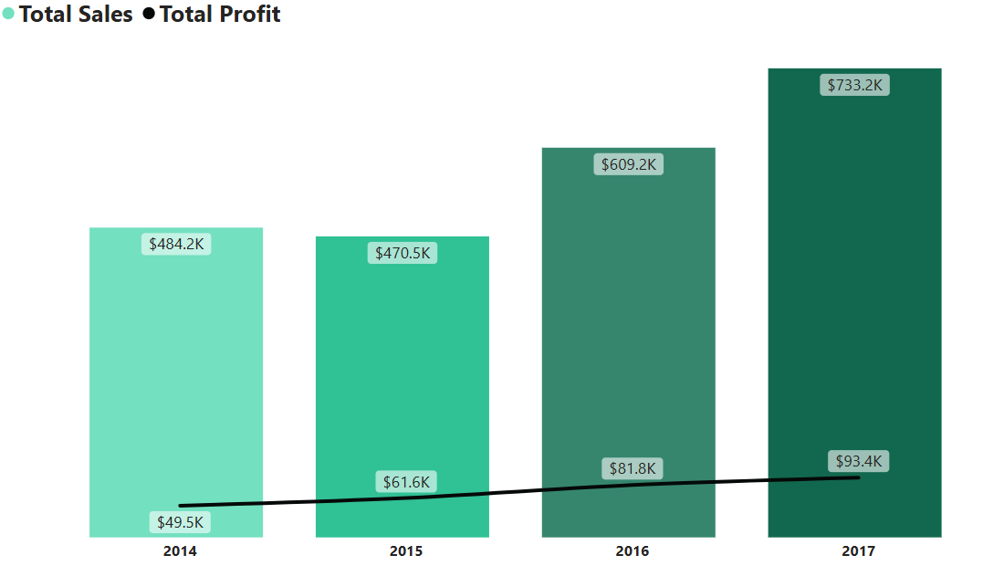

Slide 6
THE BASELINE METRICS
Seasonal Product Performance (Q3):
This seasonality leads to Question 3, What products drive revenue in these specific seasons? Over all our data shows distinct leading board with Canon imageCLASS 2200 advance Copier as the seasonal winner. In Winter, our top seller is the HP Designjet Large Format Printer. In Spring, demand shifts to the Cisco TelePresence System. By Summer, we see a spike in office essentials like Electric Letter Openers, and in Autumn, the Canon imageCLASS Copier takes the lead.

Slide 7
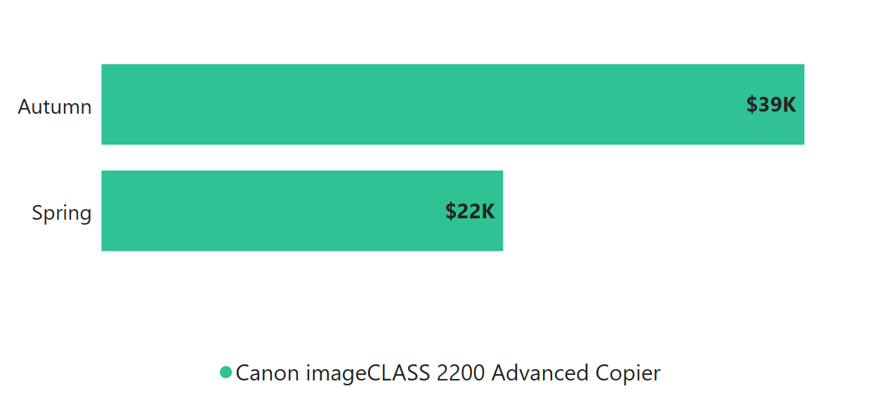

Slide 8
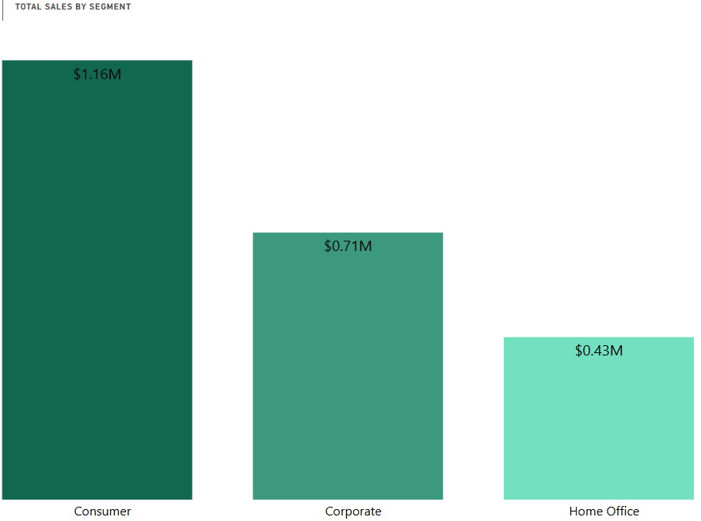
THE CUSTOMER PROFILE
Customer Spending (Q4):
Addressing Question 4, Who are our most valuable segments? The Consumer segment is by far our dominant revenue driver, contributing 1.16 million dollars—which is nearly double the Corporate segment. While we value our Corporate and Home Office clients, the individual consumer keeps the lights on.

Slide 9
THE CUSTOMER PROFILE
Discounts & Behaviour (Q5):
Question 5 asked how discounts affect purchasing behaviour? At 0% discount, volume is the highest mainly for FURNIITURE and OFFICE SUPPLIES. However, however as discount increase to 20% - 40%, the visual shows Technology products responding with higher proportional sales.
With this Executives should not assume discounting benefits all product lines equally because extremely high discount don’t boost quantity significantly and could be margin-destroying.
Our recommendation will be for the company to have a tailored discount strategy in other to avoid blanket discount policies and also overlay profit margin to determine if increased quantities just discount cost (important in retail B&B) and similar issue goes to question (14) below.

Slide 10
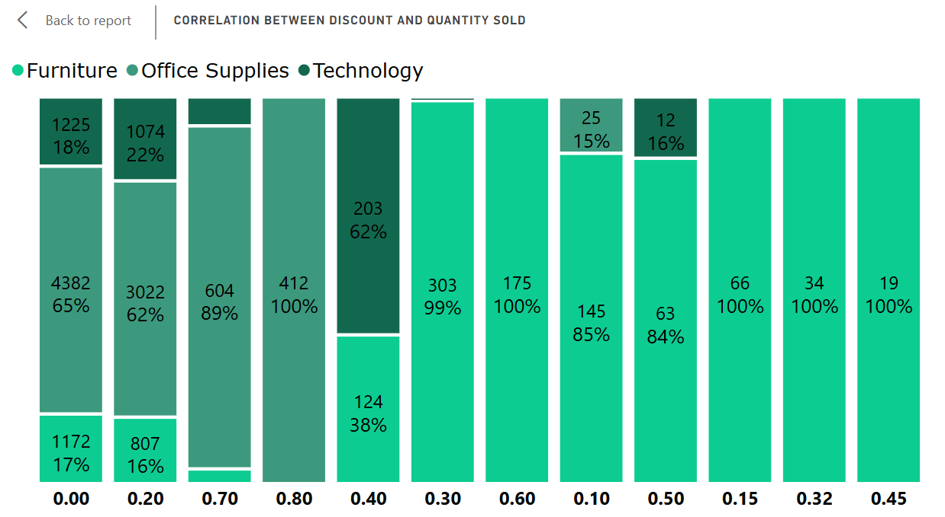

Slide 11
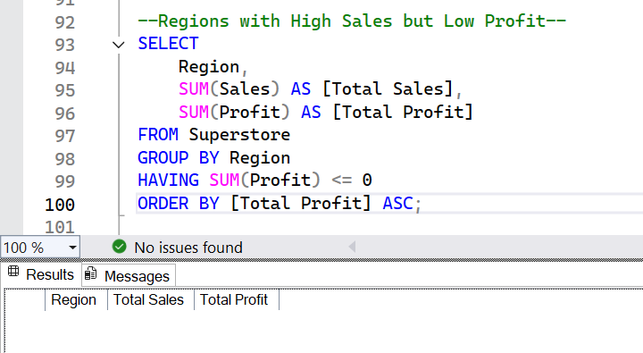
Market Dynamics & Portfolio Performance
Return Rates (Q6):
Regarding Question 6 on return rates. I must highlight a gap in our data governance here. The current dataset does not flag returned items or negative quantities. We cannot currently calculate return rates, and I have flagged this as a priority fix for our IT team to ensure we can track this metric in Q3.

Slide 12
Market Dynamics & Portfolio Performance
Peaks and Troughs (Q7):
When do we perform best and worst? Aligning with our seasonal findings, our Peak Performance was recorded in March 2017, our highest sales month on record. Conversely, our Lowest Performance consistently falls in February, with June 2014 being our historic floor. June is effectively our 'off-season'.

Slide 13
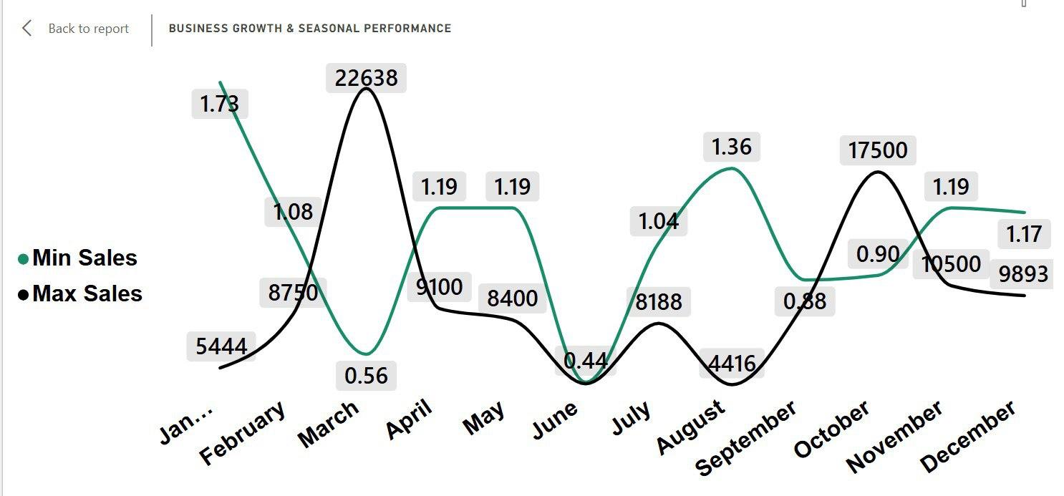

Slide 14
Market Dynamics & Portfolio Performance
Top 10 Products (Q8):
What are our star products by Sales & Profit? The clear winner for both Sales and Profit is the Canon imageCLASS 2200 Advanced Copier. It generated 61,000 dollars in sales and 25,000 dollars in pure profit. It is the anchor of our portfolio.

Slide 15
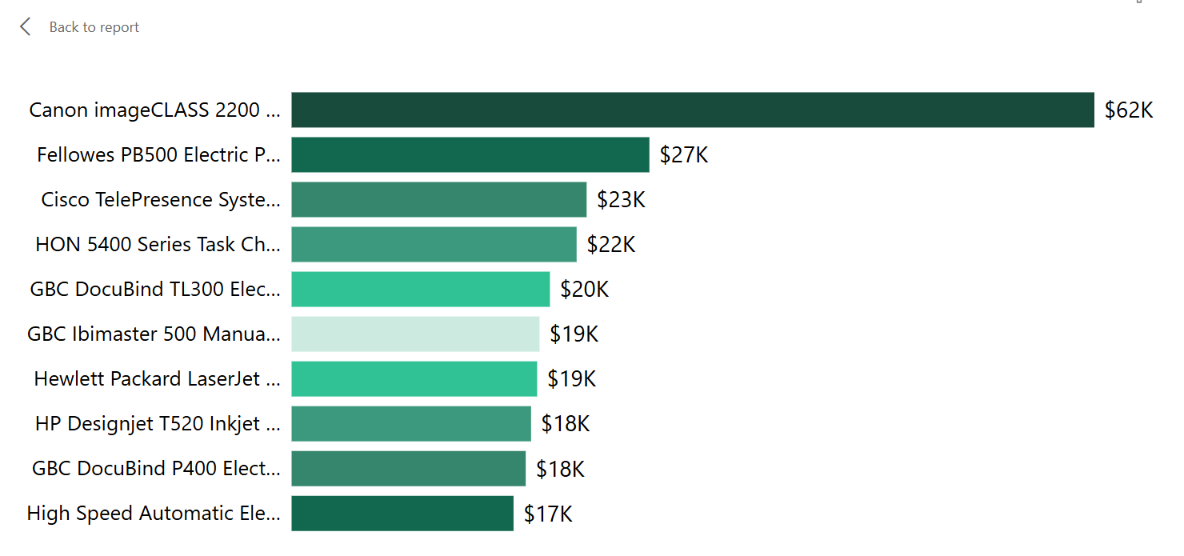
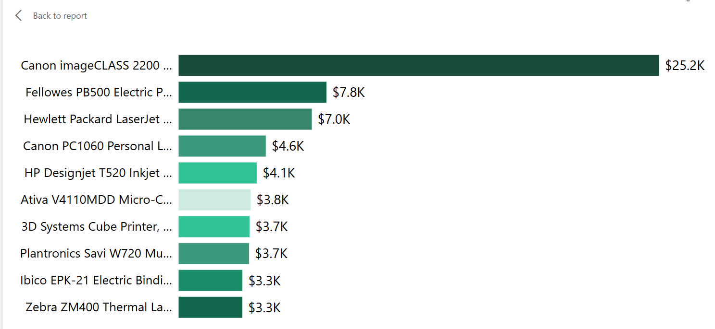

Slide 16
Market Dynamics & Portfolio Performance
Product with high sales and negative profit (Q9):
Are there product with high sales but negative profit? The majority of our products follow a healthy trend where higher sales correlate with higher profit. However, there is a significant outlier in the bottom-right quadrant (indicated in the green shaded area).
The 'Value Destroyer': We have one specific product (the brown data point) generating approximately $4.5K in sales but resulting in negative profit. This indicates that the more we sell of this item, the more money the company loses.
Underperformers: There is a second high-volume product (the magenta point) generating over $3.5K in sales with a disproportionately low profit margin compared to lower-volume items.
Recommended: We need to immediately review the pricing strategy for the negative-profit outlier. It is likely priced too low to cover its COGS (Cost of Goods Sold) or associated shipping/overhead, and We should consider whether to "de-market" this product or transition customers to the high-margin alternatives identified in the top-left of the chart.

Slide 17
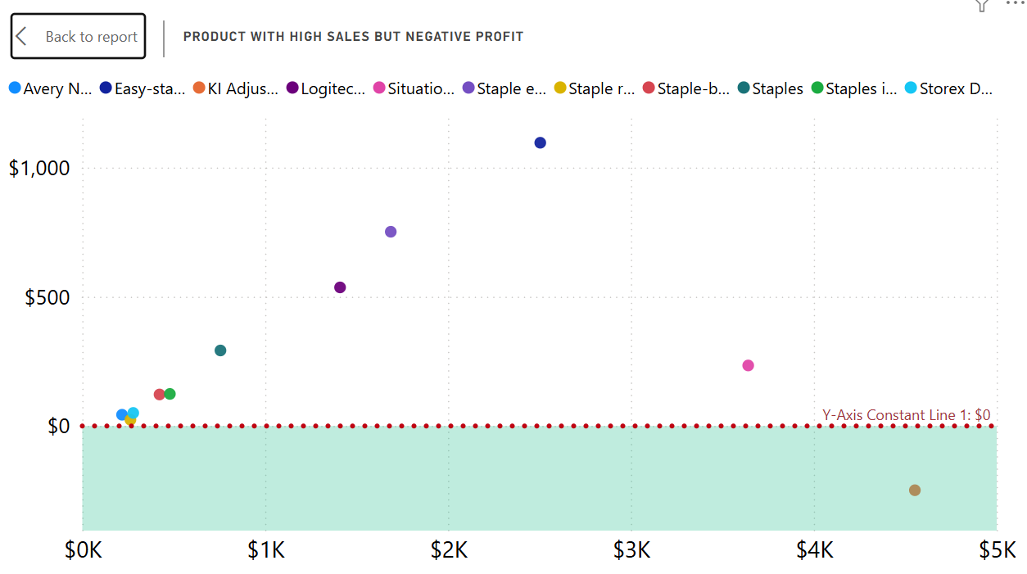

Slide 18
Market Dynamics & Portfolio Performance
Category contribution to sales(Q10):
How much does each category contribute to total sales? Our revenue streams are remarkably well-balanced, with our three core categories each contributing approximately one-third of our total sales volume.
Leading Segment: Technology is our strongest category, accounting for $836.15K (36.4%) of total revenue.Secondary Drivers: Furniture follows closely at $742K (32.3%), with Office Supplies rounding out the portfolio at $719.05K (31.3%).Low Concentration Risk: From a strategic standpoint, we are not over-reliant on a single category. Even our smallest segment (Office Supplies) is within 5 percentage points of our largest, indicating a very stable and diversified revenue base.

Slide 19
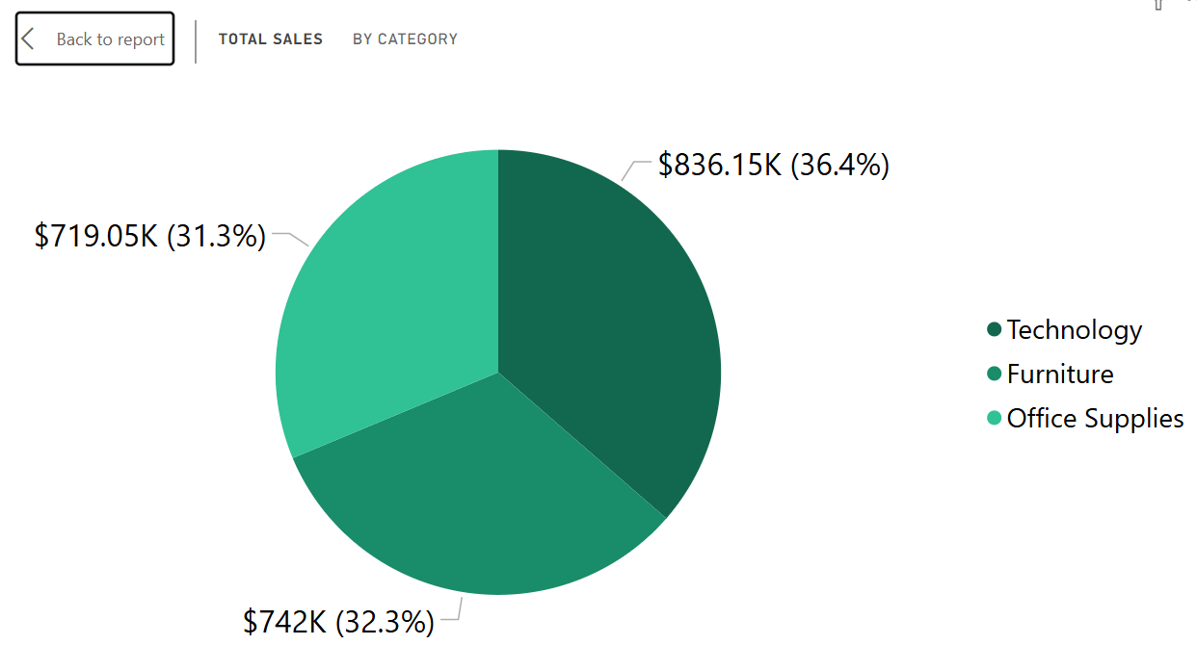

Slide 20
Strategic Optimization & Risk Intelligenc
Customer Frequency (Q11):
Question 11 asks about loyalty. Who orders most frequently? Our top customer is Emily Phan, with 17 distinct orders. She is followed by a cohort of loyalists with 13 orders each. These are our 'Super Users', yet our current marketing treats them the same as one-time buyers.

Slide 21
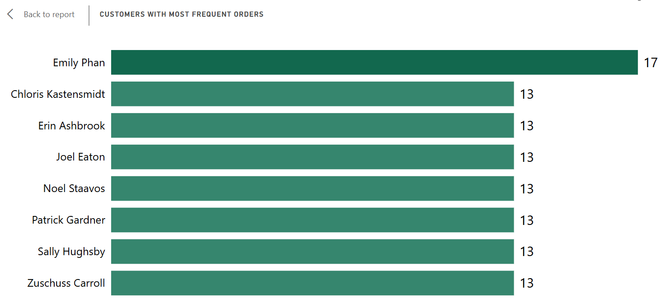

Slide 22
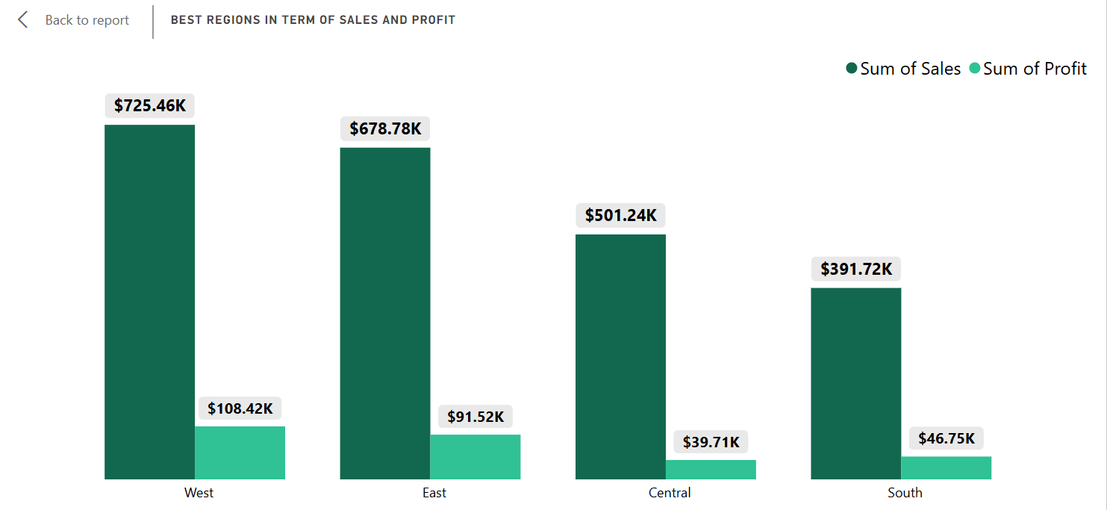
Strategic Optimization & Risk Intelligenc
Best performing regios,states, and cities in term of profit & sales (Q12):

Slide 23
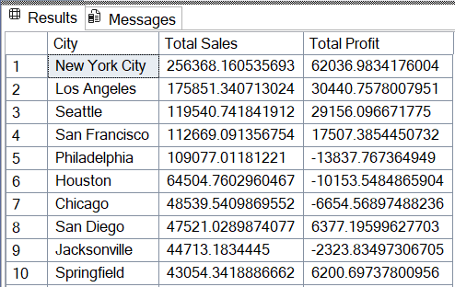
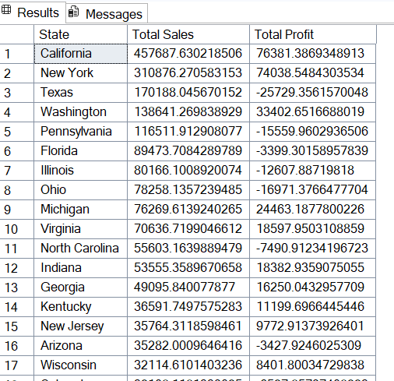

Slide 24
Strategic Optimization & Risk Intelligenc
The Discount Profitability Cliff (Q14):
How do discounts impact profitability? This visual show how different discount levels impact total profit. It helps determine whether discounting generates or destroys values.
At 0% discount, the business generates its highest profit which is +$321k profit but as discount start increasing:
At 20% discount, profit drops sharply to +$90k
At 10% discount, profit barely holds at +$9k
At 15% discount, profit drop drastically to +$1k
After that the more the discount is above 30% the company only incure Negative profit.

Slide 25
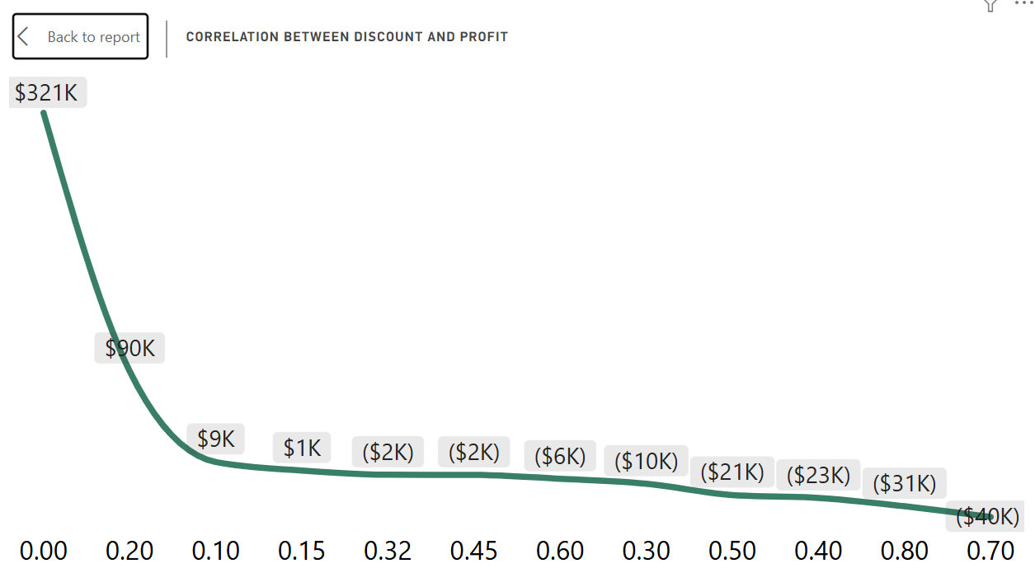

Slide 26
STRATEGIC RECOMMENDATION
Enforce a 20% Discount Cap: The data is undeniable, profits crash once discounts exceed 20%. No discount above 20% should be allowed without Manager's approval. This stops the bleeding identified in Question 5&14.
Delist Unprofitable Products: Ee must remove the Cubify 3D Printers and Lexmark Units identified in Question 9 from our active catalogue immediately. They are dragging down our Technology margins.
Regional Intervention in the Central Region: The Central Region (Texas/Illinois) is driving volume but destroying profit. SmartMart should investigate if loval competitors are forcing aggressive price ward or if regional shipping costs are too high. Consider localized pricing in these states.
Seasonal Inventory Alignment: We should align our procurement with the seasonal peaks identified in Question 3 -- stocking HP Printers in winter and Canon Copiers in Autumn to maximize our best months.
Customer Loyalty Program: Target the top 10 unique customers (identified via out RANK measure) with a VIP program. Retaining a high-value Customer like Emily Phan is significantly cheaper than acquiring new customers in the slow months.

Slide 27
Active Group Members
Gabriel Afolami DA/2025/TC4/624
Opeloyeru Eniola Comfort DA/2025/TC4/625
Abolade Eniola SururahDA/2025/TC4/628
Toritseju Ofeoritse MarxDA/2025/TC4/627
Adebayo Abdulfatai AyindeDA/2025/640
Ifeoluwa EstherDA/2025/TC4/638
Folahanmi Omogoriola EbenezerDA/2025/TC4/642
Ajetunmobi Moyosoluwa MisturaDA/2025/TC4/632
John AkinwandeDA/2025/TC4/636

Slide 28
THANK YOU

